Slide 1
git & github
trevor strieber

Slide 2
who am i?
ARMSTRONG GRADUATE
SOFTWARE DEVELOPER
ATLANTIC
@
TELE-NETWORK

Slide 3
what is git?

Slide 4
git
is a
source code
management
SYSTEM

Slide 5
git
keeps track of changes
IN YOUR CODE

Slide 6
git
FAST
works

Slide 7
git
makes it easier to work
AS A TEAM

Slide 8


Slide 9
what is
github?

Slide 10


Slide 11
github
is a place to store your
CODE

Slide 12
github
COLLABORATION
IS

Slide 13
github
COLLABORATION
IS
DISTRIBUTION

Slide 14
github
COLLABORATION
IS
DISTRIBUTION
DISCUSSION

Slide 15
github
is a

Slide 16
github
is a
social network

Slide 17
github
is a
social network
for NERDS

Slide 18
github
is a
social network
for NERDS

Slide 19
github
is a
social network
for DEVELOPERS

Slide 20
HOW DOES IT
WORK?

Slide 21
WINDOWS
installation
MSYSGIT
http://msysgit.github.io/

Slide 22
OSX
installation
GIT
already installed

Slide 23
OSX
installation
WANT NEWER GIT?
check out homebrew
http://brew.sh/

Slide 24
LINUX
installation
USE YOUR
package manager

Slide 25
LINUX
installation
Ubuntu / Mint
apt-get

Slide 26
LINUX
installation
CentOS / Fedora
yum

Slide 27
CREATING
A REPOSITORY

Slide 28
git init
[trevor:~/sweet_app]$ git init
Initialized empty Git repository in /home/trevor/sweet_app/.git/

Slide 29
NOW WHAT?

Slide 30
do work
NOW WHAT?

Slide 31
edit files
[trevor:~/sweet_app]$ vim hello_world.rb

Slide 32
git status
[trevor:~/sweet_app]$ git status
# On branch master
#
# Initial commit
#
# Untracked files:
# (use “git add <file>…” to include in what will be committed)
#
# hello_world.rb

Slide 33
TRACKING
new files

Slide 34
git add
[trevor:~/sweet_app]$ git add hello_world.rb

Slide 35
HOW ARE WE
looking?

Slide 36
git status
[trevor:~/sweet_app]$ git status
# On branch master
#
# Initial commit
#
# Changes to be committed:
# (use “git rm --cached <file>…” to unstage
#
# new file: hello_world.rb

Slide 37
WHAT IS A
commit?

Slide 38
COMMIT:
a snapshot of your code

Slide 39
git commit
[trevor:~/sweet_app]$ git commit –m ‘Initial commit!’
[master (root-commit) f888f95 Initial commit!
1 files changed, 2 insertions(+), 0 deletions(-)
create mode 100644 hello_world.rb

Slide 40
CLEAN:
no unsaved changes

Slide 41
git status
[trevor:~/sweet_app]$ git status
# On branch master
Nothing to commit (working directory clean)

Slide 42

code
SHARING

Slide 43
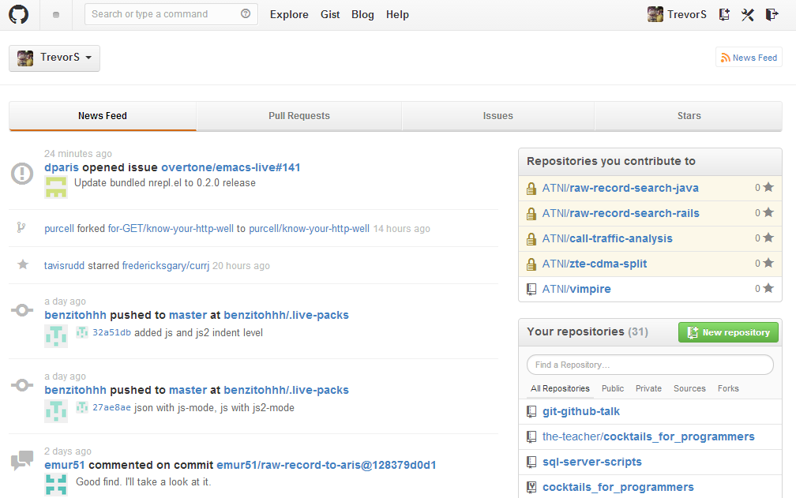
GitHub

Slide 44
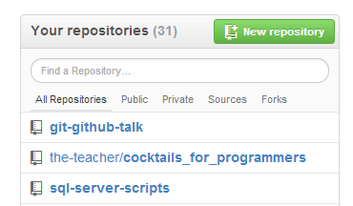
create a repository

Slide 45
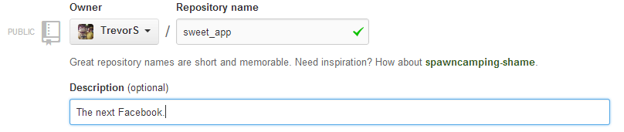
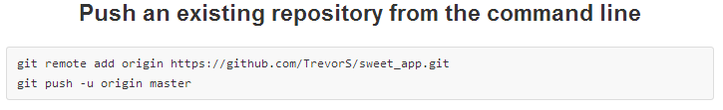
pick a name
get the URL

Slide 46
connect the
repositories

Slide 47
git remote
[trevor:~/sweet_app]$ git remote add origin \
https://github.com/TrevorS/sweet_app.git

Slide 48
upload your
changes

Slide 49
git push
[trevor:~/sweet_app]$ git push –u origin master
Username for ‘https://github.com’: TrevorS
Password for ‘https://TrevorS@github.com’:
Counting objects 3, done.
Writing objects: 100% (3/3), 258 bytes, done.
Total 3 (delta 0), reused 0 (delta 0)
To https://github.com/TrevorS/sweet_app.git
* [new branch] master -> master
Branch master set up to track remote branch master from origin.

Slide 50
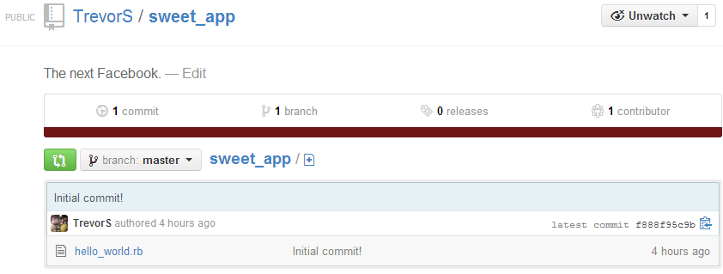
ADMIRE
YOUR RESULTS

Slide 51
these are the basics

Slide 52
these are the basics
LEARN MORE

Slide 53
these are the basics
LEARN MORE
SHOW OFF

